Slide 1
Customer stories
Author name
Date

Slide 2
Mercedes-Benz R&D creates container-driven cars powered by Microsoft Azure
“
Azure provides the global datacenter footprint and geo-replicated services needed to ensure operational efficiency, minimal latency, and smooth deployment of updates across the world.”
Challenge: | The infotainment system in a car runs software that was flashed as a monolith when a vehicle rolled off the factory line. Developing an app for such system requires a deep understanding of the hardware architecture and the low- level functionality and coordination across multiple teams. Additionally, software updates would only be possible at authorized Mercedes-Benz service locations once or twice per year.
Solution: | Using containers, developers can build, test and run apps on emulators. After these automated tests are run in simulated vehicles in the cloud, apps can run on a test car. The test car’s head unit connects to the cloud during vehicle ignition, locates the newly assigned app, retrieves its metadata, pulls the described container image, and starts the app.
Outcome: | By containerizing the head unit apps and using Azure application services, the team can keep the software inside of the cars updated and release new features in weeks instead of months, while preserving quality and security of vehicle and driver data.
Thomas Spatzier, Cloud Architect, Mercedes-Benz Research & Development
Click icon to learn more
Notes:
https://customers.microsoft.com/en-us/story/784791-mercedes-benz-r-and-d-creates-container-driven-cars-powered-by-microsoft-azure

Slide 3
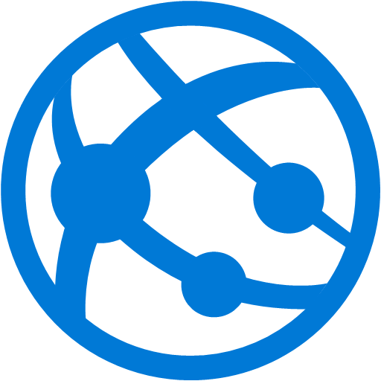
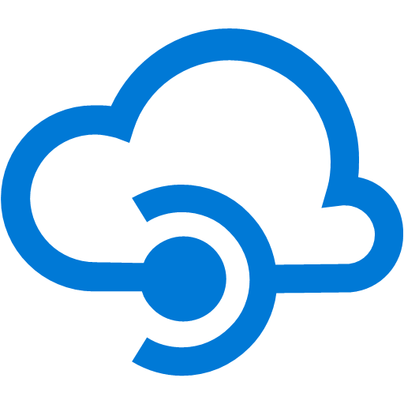
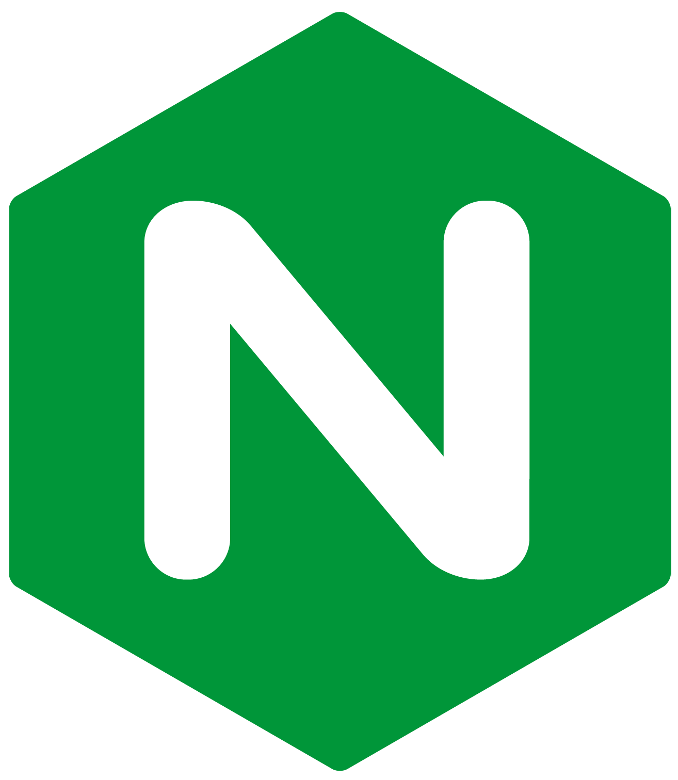
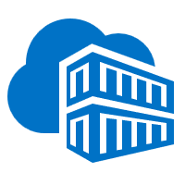
Mercedes-Benz R&D: architecture
Developer portal
Development team
5
3
Azure
Developer creates new in-car application.
The creation triggers the orchestration service, which provisions a source code repository for the application.
Developers can work using containers and deploy to ab emulator running in a virtual machine.
A CI/CD pipelines that build the code into containers is automatically created. Pipelines control deployment to the integration environment and registers the application metadata in Azure Cosmos DB.
During vehicle ignition, the car’s head unit connects to the service, locates the newly assigned app, retrieves its metadata, pulls the described container image from the closest data center and starts the app.
Web app
API Management
Create application
App creation portal
1
Azure Kubernetes Service
Orchestration services
2
Nginx ingress
Source code repo service
Feature configuration service
Multi-region/ Geo-replication
CI/CD pipeline
Cosmos DB
DevOps
ACR
Web app
4
Container images
Feature toggle portal
Metadata

Slide 4


Bosch Increases Vehicle Safety Using Precision GPS Algorithms and Azure Kubernetes Service
“
What we like about AKS is the simplified Kubernetes experience. It's click and deploy, it’s click and scale. It’s infrastructure as code too, which is quite cool for us.”
Challenge: | Bosch designed a software development kit (SDK) that can be used by original equipment manufacturers (OEMs) to embed driving safety information at scale. For such a service to work commercially, they had to build a real-time data ingestion and processing pipeline capable of detecting hazards and notifying drivers within seconds
Solution: | The solution is deployed as multiple microservices running in containers behind an Azure API Management gateway. AKS provided the simplicity a serverless Kubernetes experience that provided the elastic provisioning they wanted without the need to manage the infrastructure.
Outcome: | By running their solution, which has been downloaded by 12 million users, on Azure and AKS, the average time to detect driving hazards dropped to approximately 60 milliseconds.
Christian Jeschke, Product Owner, Bosch
Click icon to learn more

Slide 5
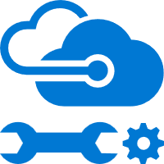

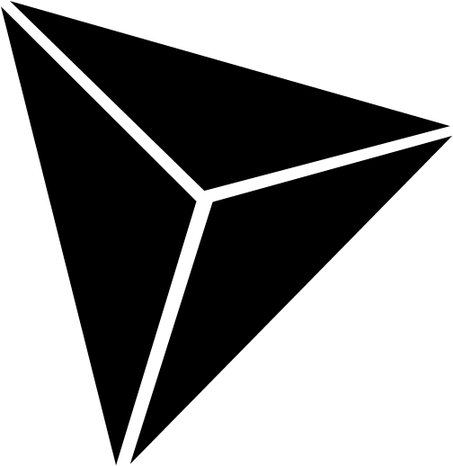
Bosch: architecture
SDK Hotspots
WDW Service
Public API
Key Vault
Sensor data is generated and streamed to Azure API Management
AKS cluster runs microservice that are deployed as containers behind a service mesh; containers are built using a DevOps process and stored in Azure Container Registry
Ingest service stores data in an Azure Cosmos DB and other data storage destinations
Asynchronously, the map matching service receives the data from Kafka Streams on Azure HDInsight
Data is processed and stored the result in Azure Database for PostgreSQL and maps are continuously updated using Azure Databricks
A web app running in Azure App Service is used to visualize the results
Web Apps
6
1
VNet Security
mVISE
AKS Service
Kafka Streams on HD Insights
AKS Map matching
ACR
2
4
3
5
Data Explorer Clusters
Blob Storage
Cosmos DB
Cache for Redis
PostgreSQL Server
Databricks

Slide 6

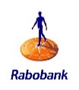
Rabobank and Accenture embrace digital transformation with Blockchain on Azure
“
The fact that we were able to implement a cloud solution that can comply with all our strict security and compliance requirements is an architectural highlight. This project can be used as a blueprint for new initiatives.”
Challenge: | Until recently, Rabobank’s Trade Commodity Finance group was steeped in manual, paper-based processes. Transactions required a conversation over the phone or in email between the traders and bank employees, followed by manual data entry into a product administration system. Rabobank wanted to modernize by replacing these slow processes and by implementing a more secure, streamlined digital channel of trade.
Solution: | Adopting a transformative cloud-first strategy with help from Accenture, Rabobank began running the blockchain workload called Komgo on Azure. Komgo is a global blockchain-based trade financing platform backed by 15 of the world’s largest banking and commodity companies. The solution runs the Komgo software in secure containers that are managed by Azure Kubernetes Service (AKS).
Outcome: | In blockchain, Rabobank saw the opportunity to meet its goals— to digitize and transform commodities trade finance in a way that improved both operational efficiency and data quality, embracing digital transformation. Now Rabobank is poised for the future with all the benefits of Azure, including automation that streamlines deployment and an improved security stance. Komgo represents a new way of doing business, and Rabobank’s implementation on Azure represents the bleeding edge of blockchain technology in the cloud.
Martijn Ruff, Solution Architect, Rabobank

Slide 7
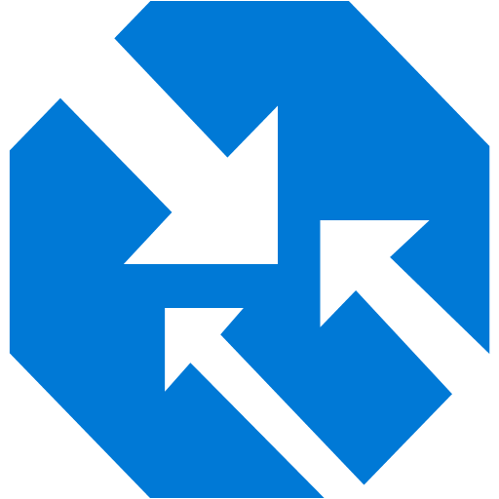
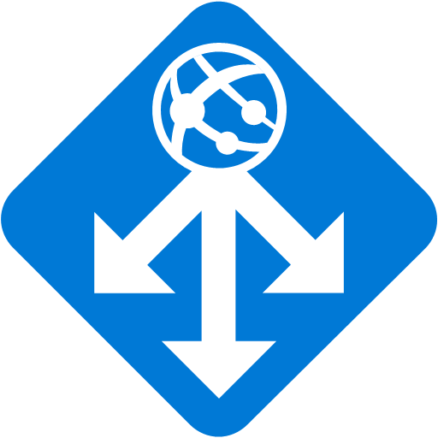
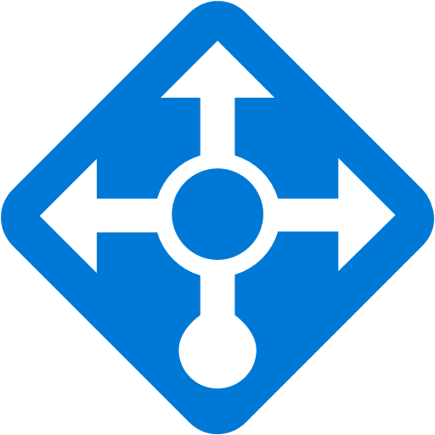
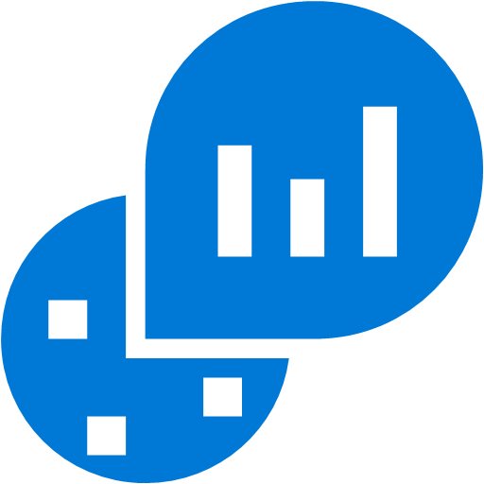
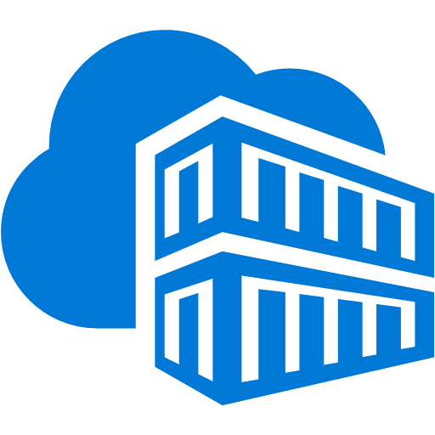
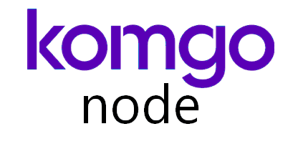


Rabobank/Accenture: architecture
Azure
Traffic Manager
Multiple Komgo containers are managed by AKS
Azure Traffic Manager maintains a static IP address configured in a secure connection between Rabobank and Azure networks
Azure Application Gateway manages traffic to the application
Azure Load Balancer provides high-performance load balancing for the incoming data
The container images are stored in Azure Container Registry
The implementation also contains Azure Database for PostgreSQL and a MongoDB database
Azure Blob storage stores the backups
Azure Key Vault safeguards all the cryptographic keys and other secrets used by the apps and services
For monitoring, Rabobank’s IT security management (ITSM) system gets log data and notifications from Azure Log Analytics
On-premises datacenter
Application Gateway
Load Balancer
Log analyzer
Rabobank ITSM
User
PIP
AAD w/ ADSF
Azure Kubernetes Service
ACR
Gateway
Microservices broker
Other cloud
Key cloak (IAM)
Frontend containers
Backend containers
Blockchain member node
AAD
Storage
PostgreSQL
MongoDB
Key Vault

Slide 8


Kainos and NHSX deliver health services to millions on Microsoft Azure
“
Azure, AKS, and Azure Cosmos DB give us an enterprise-grade solution with speed, scalability, and adaptability, plus the availability of an active-active multiregion configuration.”
Challenge: | The National Health Service (NHS) wanted a mobile solution as a front door to healthcare services for patients in England. The challenge was to integrate systems across the offices of 7,500 general practitioners who book more than 340 million appointments annually and order 800 million repeat prescriptions. NHSX had never used a public cloud for hosting and delivering a user-facing transactional service.
Solution: | The NHS App uses a containerized architecture on Azure. Kainos, a cloud solution provider, delivered a highly secure service based on Docker, Azure Container Registry, Azure Kubernetes Service (AKS), and open-source tooling at scale. AKS offers a hosted experience that reduces the complexity and operational overhead of managing Kubernetes, helping Kainos deploy a working app in only three months.
Outcome: | In this ambitious digital transformation project with NHS Digital and NHSX, Kainos broke new ground by using the Azure public cloud to host a user-facing transactional service empowering 40 million people to access healthcare services using smartphone-native apps. Kainos brought the project from an idea to a live service in just 13 months.
Caoimhin Graham, Principal Architect Kainos

Slide 9
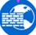

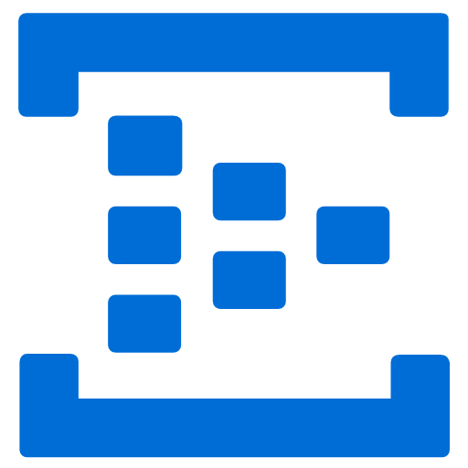
Kainos/NHSX: architecture
Akamal + Kona WAF
Internet
Traffic Manager
App subscription
The NHS App is deployed across multiple AKS clusters in several different Azure regions with requests handled in an active-active manner
Azure Traffic Manager routes inbound traffic for the service
The AKS cluster autoscaler dynamically scales node pools relative to observed demand
In the data layer, Azure Cosmos DB is deployed with a multi-master configuration to provide region resiliency
Azure Key Vault is used as a secure repository to persist and serve all passwords, keys, and cryptographic material required in delivery of the NHS App
Azure Event Hub is used as an aggregation point for all diagnostic and logging information generated within the platform
NSG
NSG
AKS subnet
AKS subnet
Ingress LB
Ingress LB
Kubernetes pods
Kubernetes pods
UK South
AKS nodes
AKS nodes
UK West
ACR
Blob Storage
Key Vault
CosmosDB
Event Hub
ACR

Slide 10


Pet care leader turns monolithic app into a global distributed solution on Azure
“
The new system on Azure is even better than we expected. It’s had a huge impact on our business and operations.”
Adam Lind, Vice President of Software Development, VCA
Challenge: | VCA, a subsidiary of Mars Petcare, is one of the largest pet healthcare companies in the United States. It wanted to streamline referrals across more than 800 of its veterinary hospitals. VCA also recognized the need to improve its practice management software (PMS) to resolve duplication and communication issues in the system.
Solution: | VCA turned to Microsoft Gold Certified Partner CloudIQ Technologies, which created a cloud-native application on Azure that solved the messy referrals problem. The resulting application, Automated Referral Function (ARF), uses containerized microservices, three data repositories, and serverless functions to eliminate duplication and to automate communications. Azure Kubernetes Service serves the key orchestration role in the automated CI/CD pipeline.
Outcome: | The extension of the PMS software to the cloud has been a great success, giving the company the flexibility to expand its services without a big investment in additional servers. With Azure, VCA has seen improved security, faster release cycles, easier management, and lower costs. Most importantly, the solution has improved communications for the veterinary hospitals and clients.
Click icon to learn more
Notes:
https://customers.microsoft.com/en-us/story/815549-pet-care-leader-turns-monolith-app-into-a-global-distributed-solution-on-azure

Slide 11

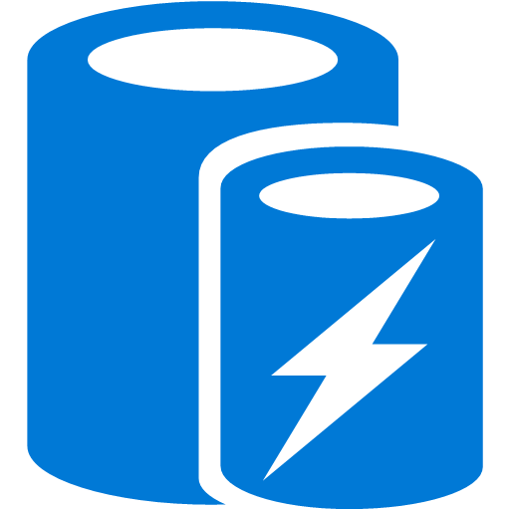

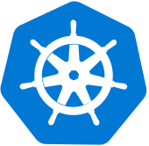


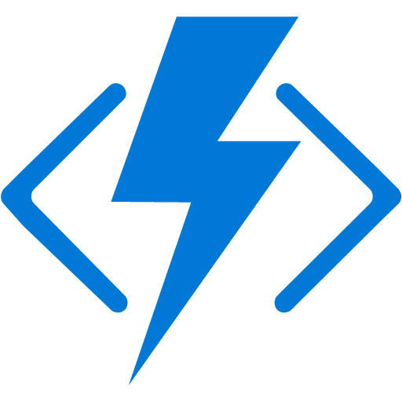
Mars Petcare/VCA/CloudIQ: architecture
Event Hub
A client application accesses the ARF API through Azure API Management
On the back end, microservices run in containers
Azure App Configuration provides a central store for all the environment-specific application settings used by the microservices
Programmers also use Azure Key Vault to store the passwords and other secrets that enable microservices to communicate
The team monitors the Kubernetes environment using Azure Monitor and Azure Log Analytics, which also track performance metrics
Azure SQL Database, Azure Cosmos DB, and Azure Cache for Redis are used for key workflows
The team also used Azure Pipelines to create a continuous integration (CI) and continuous deployment (CD) pipeline
Subscribe
Client apps
AKS
Virtual network
Backend services
Application Gateway
API Management
Cache for Redis
Ingress
Helm
CosmosDB
Helm upgrade
Pod autoscaling
Kubernetes cluster
ACR
SQL Server
Docker pull
Pod autoscaling
Docker push
Change feed
CI/CD Pipelines
AKS pod identity
App Configuration
DevOps
AAD
Monitor
Key Vault
Functions

Slide 12

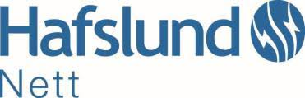
Power grid operator uses containerized software to promote smart utility initiatives for 1.5M people
“
We wanted a platform to speed development and testing but do it safely, without losing control over security and performance. That’s why Azure and AKS are the perfect fit for us.”
Challenge: | Legacy systems for reading meter data needed greater capacity to process large volumes of IoT data—but implementing the necessary system enhancements was difficult and expensive
Solution: | Hafslund chose to develop its own software for processing meter data. The company used Microsoft Azure as its cloud platform, AKS to manage software containers, and Azure Monitor for containers to optimize container performance.
Outcome: | Halfslund now has a standard way to create, monitor, scale, and manage applications, which means it can respond to customer needs faster.
Ståle Heitmann, Chief Technology Officer Hafslund Nett
Click icon to learn more

Slide 13



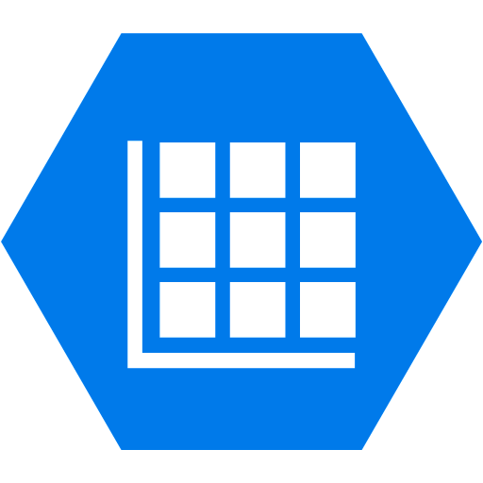

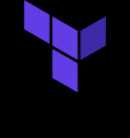
Hafslund Nett: architecture
ACR
4
2
Load Balancer External
Halsfund Nett CSS Styles
DevOps
API Mgmt.
Azure Pipelines automates container image build, push and release to Azure Kubernetes service, triggered by source code updates.
Azure Kubernetes Services provides the always-on service for meter reading and connects with Azure managed databases to process the massive amounts of data the IoT devices generate
Azure API Management serves as the secure gateway that helps connect to data and services anywhere.
Azure network and Active Directory provides fine-grain controls for external and inter-service communication.
Azure Monitor provides a single pane of glass for cluster-to-container monitoring.
Active Directory
AKS
Virtual Network
Namespace
Namespace
…
Namespace
3
Load Balancer Internal
VM
VM
VM
VM
Express Routes
…
On-prem services
Infrastructure
Cosmos DB
SQL Server
Azure Search
Table Storage
Container Monitor
…
GitHub
Log Analytics
5
Application Insights
…
Terraform
Key Vault
1

Slide 14

DNV GL scales up machine learning using Azure Kubernetes Service
“
We decided to address the friction areas of our internal company deployment, management, and operations, and after evaluating commercial offerings, we chose to develop ML Factory based on Azure services.”
Challenge: | Initially, the group trained machine learning models locally and deployed each application to Azure Virtual Machines. This process took up to 2 weeks and consumed more Azure resources than needed.
Solution: | DNV GL created a service using that builds and deploys each machine learning application as a container on AKS. They’re able to use the Kubernetes Cluster Autoscaler to add resources on demand as the need for more compute power arises.
Outcome: | Data scientists and developers at DNV GL can now deliver more solutions to their internal and external customers with more speed, for less money, and with a more elastic software stack. Now the data scientists and engineers at DNV GL can focus on developing new, predictive solutions and providing real business value.
Kristian Ramsrud, Machine Learning group DNV GL Maritime

Slide 15




DNV GL: architecture
ML Factory
Data scientists create their machine learning applications as containers using the ML Factory development tools
ML Apps are built using automatically using Azure Container Registry Tasks and are deployed to Azure Kubernetes Service
Realtime logs can be streamed directly for debugging purposes. Azure Log Analytics also provides access to historical logs within defined retention periods
As the data flows through the platform, multiple functions hosted in Azure Functions work together to fire alerts or trigger actions, triggered by signals from Azure Event Grid
Published applications are automatically added to the company’s corporate API Management gateway and the internal API catalog
5
API Gateway
2
API Management
AKS
Consuming applications
Support components
3
ML development and monitoring
1
Active Directory
App Service
Key Vault
ML Factory Web portal
Blob Storage
Storage Accounts
ACR
ML Factory Developer tools
SQL Server
Event Grid
Function Apps
4

Slide 16
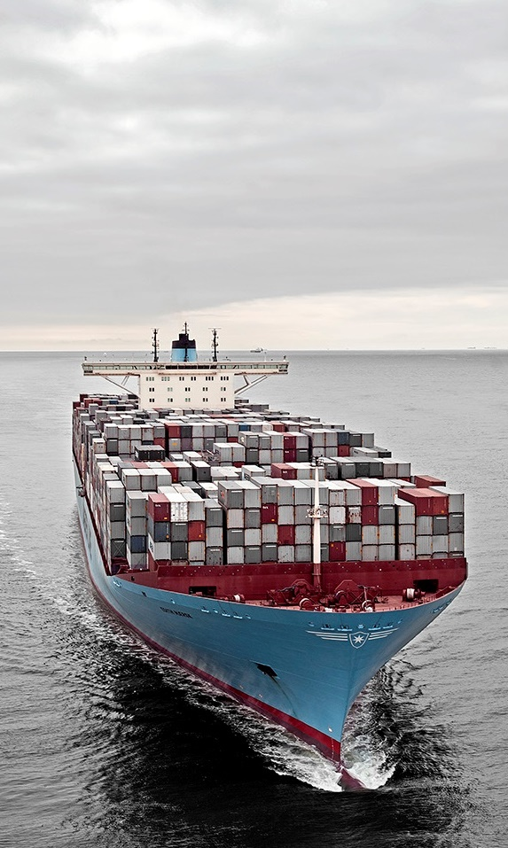

Maersk uses AKS for a customer service process to elevate NSAT, an industry-wide challenge
“
Using Kubernetes on Azure satisfies our objectives for efficient software development. It aligns well with our digital plans and our choice of open-source solutions for specific programming languages.”
Needs: | Get near-real-time data to provide better customer service Collect data for future Machine Learning driven features
Challenges: | Compute & memory intensive features Data integration difficulties Limited organisational experience in Cloud & Kubernetes
Requirements: | Spend less time on container software management Automation and continuous delivery Full visibility to application, container and infrastructure Fine grained security and access control
Outcomes: | Reduced environment provisioning time from 1+ weeks to 2.5 hours AKS and CaaS can potentially save 33% on run cost
Rasmus Hald, Head of Cloud Architecture, A.P. Moller - Maersk
Click icon to learn more

Slide 17



Maersk: architecture
App Gateway
Azure Pipelines for automation and CI/CD pipelines; adding Terraform for further automation
Firewall
Azure Pipelines
AKS w/ RBAC
Data Factory
Data Management Gateway
On-premises database
Key Vault to secure secrets and for persistent configuration store
1
4
Express Route
Key Vault
SQL Database
Azure Monitor for containers to provide better logging, troubleshooting, with no direct container access
2
SQL Database
Cosmos DB
Azure Monitor
Event Hub
3
Performance Document DB
RBAC control for fine grained Kubernetes resources access control
App Insights
Batch processing
Event Simulation
Service Bus
Internal Queuing

Slide 18


Xerox moves to containers in Azure for faster demo environment releases
“
Thanks to Azure Kubernetes Service, we can now spin up new demo environments in 10 minutes instead of 24 hours. Moving Docushare Flex from virtual machines to containers in Azure allows us to provision environments faster, empowering our sales and partner network.”
Robert Bingham, Director of DocuShare Cloud Operations, Xerox
Benefits: | Onboard prospective customers faster through automation Enable self-service demo environments for large partners Reduce administrative overhead for small Ops team No code modification required

Slide 19

Xerox Docushare Flex—Before
Internet
Typical 3-tier architecture using VMs
Virtual Machines
Customer A
Customer B
Customer C
Each customer instance assigned to dedicated Java and Postgres VMs
Set of backing services for authentication, file sharing, common data sources
Java
Java
Java
Postgres
Postgres
Postgres
Problem: Due to overhead and management burden of VMs, adding a new customer takes 24 hours, slowing down customer onboarding through sales and partner network
Backing Services
LDAP
SFTP
PRIZM

Slide 20
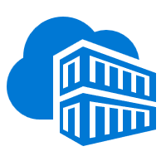
Xerox Docushare Flex—After
Internet
Typical 3-tier architecture using VMs
AKS
Convert Postgres database to a shared backing service
Run Java application in containers with no code modification
Switch to NGINX-based web-tier with LetsEncrypt for free SSL/TLS
New Helm chart created to automate customer onboarding to AKS
Azure Container Registry
NGINX
Customer A
Customer B
Customer C
Java
Java
Java
Outcome: Run the Java application in containers on AKS, decreasing provisioning time from 24 hours to 10 minutes, accelerating sales and customer onboarding with no code changes required
Backing Services
LDAP
SFTP
PRIZM
Postgres

Slide 21


Cloud computing supports value-based care development for medical technology provider
“
Using Azure Kubernetes Service puts us into a position to not only deploy our business logic in Docker containers, including the orchestration, but also … to easily manage the exposure and control and meter the access.”
Challenge: | Siemens Healthineers wanted to develop more of its solutions in the cloud—on-premises systems were proving complicated for data aggregation and analytics—but strict compliance requirements were making that transition tricky.
Solution: | The company selected Microsoft Azure for its cloud development platform thanks in large part to the number of regulatory certifications Azure has earned worldwide. With that decision, the company now deploys its distributed applications in Docker containers, orchestrates those containers using Kubernetes, and monitors and manages the environment with AKS.
Outcome: | AKS enables developers to quickly and easily work with their applications with minimal operations and maintenance overhead, leading to shorter release cycles and helping the company achieve its desired continuous delivery approach.
Thomas Gossler, Lead Architect, Digital Ecosystem Platform Siemens Healthineers
Click icon to learn more

Slide 22


Ambit Energy uses cloud to electrify pace of innovation and expansion
“
Azure support for Docker, Kubernetes, Puppet, Terraform, Cassandra, and other open source tools has become very important to us and has really accelerated our move into Azure.”
Challenge: | To meet aggressive growth goals, Ambit Energy needed to automate infrastructure provisioning to match their pace of new software creation.
Solution: | To stand up infrastructure quickly, Ambit used Microsoft Azure services such as Azure Container Service, together with infrastructure as code and open source technologies, to completely automate infrastructure provisioning.
Outcome: | By implementing Azure, Ambit can move dramatically faster to enhance its services and enter new markets. Infrastructure redundancy is flexible and worry-free. And costs are 22 percent lower, which helps Ambit compete in the crowded electricity market.
Robert Rudduck, Director of Architecture and DevOps, Ambit Energy

Slide 23


Altair Engineering uses cloud to democratize HPC access
“
Customers are limited as to what they can do on workstations, but with Azure we can give them a scalable, cost-effective back-end HPC infrastructure.”
Challenge: | Altair needed a specialized HPC architecture containing high-performance graphics processing units to deliver their latest topology optimization and analysis application to customers.
Solution: | Altair used Kubernetes in Azure Container Service to handle back-end functions and increase the density of services running across compute nodes.
Outcome: | With Azure, Altair provides customers with a scalable, cost-effective back-end HPC infrastructure, eliminating the need for expensive engineering workstations.
Sam Mahalingam, Chief Technical Officer Cloud Computing and High-Performance Computing Strategy, Altair Engineering
Click icon to learn more

Slide 24
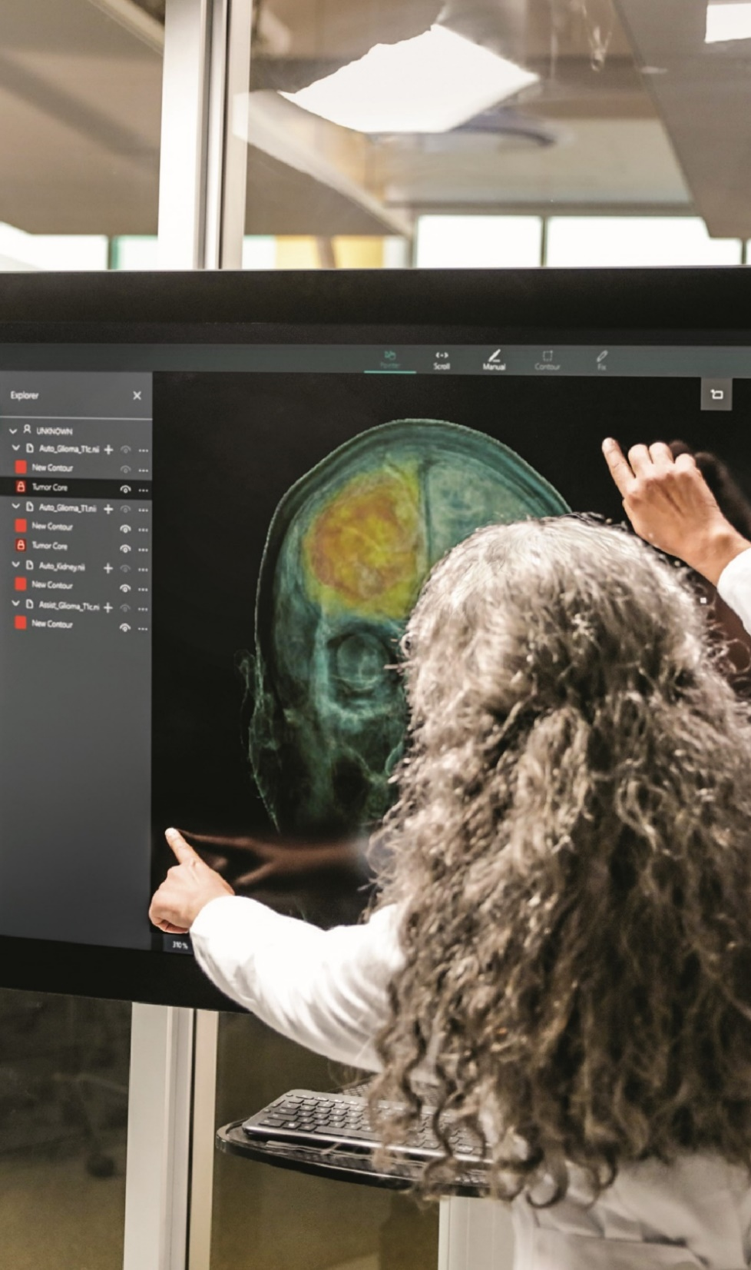

Varian uses cloud and container software technology to streamline IT and focus on innovation
“
With AKS, developers get a safe place to innovate and to experiment with new technologies and ideas…It’s the best of open service combined with the best of Azure.”
Challenge: | Varian needed to provide broader cancer care and enable faster innovation for the benefit of cancer patients.
Solution: | Varian chose Microsoft Azure as its cloud platform and Azure Kubernetes Service to scale application deployments to thousands of customers, utilizing containers to modernize existing apps and create new ones.
Outcome: | With AKS, Varian’s developers can deliver features to customers quickly and get their feedback without the overhead of provisioning a group of virtual machines.
Shivakumar Gopalakrishnan Senior Manager, Varian Medical Systems
Click icon to learn more

Slide 25


Falkonry uses cloud and machine learning to create a “data scientist in a box”
“
We’re very happy with the speed of deployment we can offer our customers with Azure. If we had to fly people out to configure and set up hardware and software, we would lose several weeks in the process.”
Challenge: | Falkonry needed a solution to scale the deployment of its machine learning application to reach customers in the oil and gas industries.
Solution: | Falkonry used Azure Kubernetes Service to automate the deployment of Kubernetes clusters to deliver their application globally.
Outcome: | With Azure Kubernetes Service, Falkonry is able to deploy their solutions in days, compared to months it takes for companies using a more traditional platform approach.
Sanket Amberkar, Senior VP of Marketing, Falkonry

Slide 26


OpenAI uses cloud to drive flexibility and scalability for deep learning experiments
“
Because Kubernetes provides a consistent API, we can move our research experiments very easily between clusters… [We] have a number of teams that run their experiments both in Azure and in our own data centers, just depending on which cluster has free capacity, and that's hugely valuable.”
Challenge: | OpenAI needed infrastructure for deep learning that would allow experiments to run either in the cloud or in its own data center, and to easily scale.
Solution: | OpenAI migrated its Kubernetes clusters to Azure, running key experiments in fields including robotics and gaming both in Azure and in its own data centers.
Outcome: | Researchers now spend far less time launching experiments and scaling them out to hundreds of GPUs. OpenAI has also benefited from greater portability and lower costs given the ability to use its own data centers when appropriate.
Christopher Berner, Head of Infrastructure, OpenAI
Click icon to learn more

Slide 27


Eni quickly delivers business applications using Azure Kubernetes Service
“
AKS allows us to deploy and run containers very fast, without dealing with the burden of allocating VMs, storage, and configuring networking. Moreover, changing decisions about deployment parameters is quick and easy.”
Challenge: | Eni wanted to find a cloud service that met its goal to avoid Kubernetes vendor lock-in while creating an infrastructure where project onboarding happened fast and developers could begin work immediately.
Solution: | After starting with Kubernetes on premises, Eni expanded to the cloud and added Microsoft Azure Kubernetes Service (AKS). The hybrid platform includes a suite of open-source tools and supports infrastructure as code (IaC).
Outcome: | Eni achieved a full infrastructure as code scenario using Terraform and Azure, and now has native cloud speed along with enterprise-grade controls and configurations, with everything stored and enforced through code.
Giuseppe Zicari, Cloud Architect, Eni SpA
Click icon to learn more

Slide 28
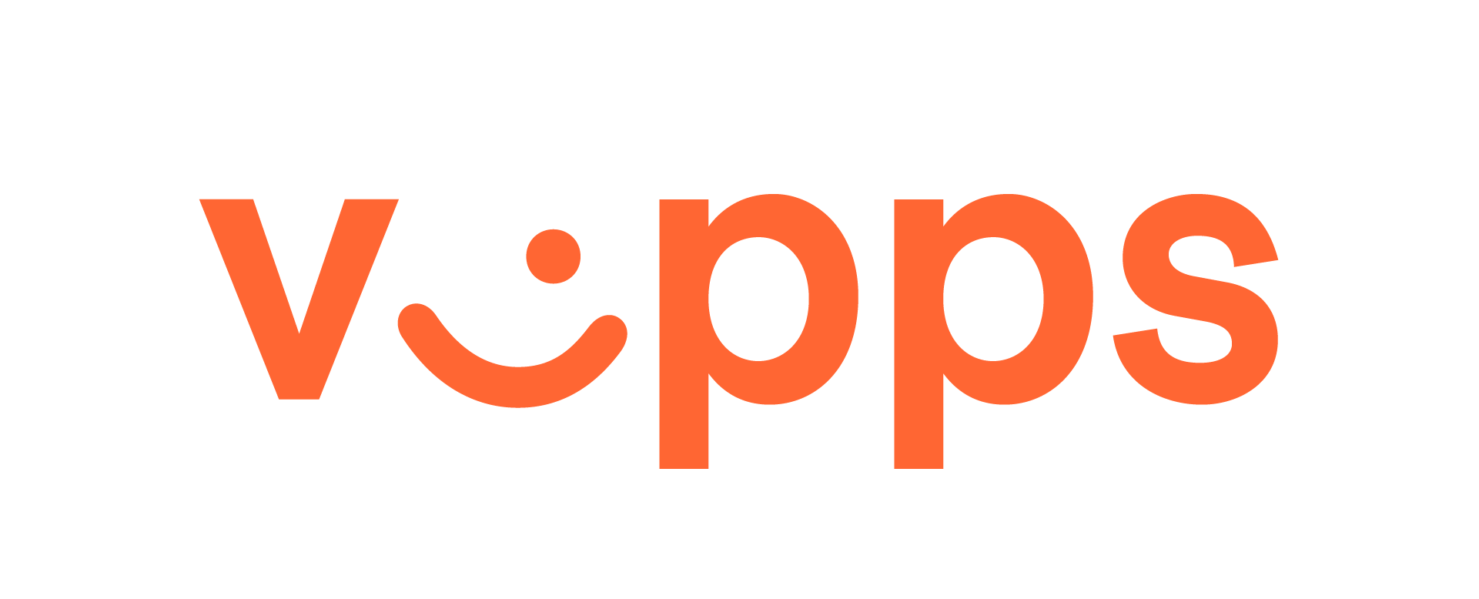

From monolith to microservices, Vipps transforms into a cloud-native company
“
With Azure, we can scale Vipps as it grows and streamline future development, upgrades, and innovation. That allows us to focus less on operations and more on building new services, creating value, and competing effectively.”
Challenge: | Vipps, a mobile payment app for smartphones developed by Norweign savings bank DNB, was built on-premises using a monolithic architecture. The app’s wild success—Norwegians don’t just send money anymore; they Vippse it—required a fundamental overhaul.
Solution: | Vipps experimented with different approaches for transitioning to a microservices architecture from the original monolithic one. The goal was to determine how to separate functional concerns while maintaining velocity and speed. After multiple iterations, starting with simple VMs, Vipps chose Azure Kubernetes Service (AKS) in conjunction with Azure API Management to effectively develop, deploy, and manage the microservices transition.
Technology: | Vipps used a variety of Azure products to make this transition, including AKS, Azure API Management, Azure SQL Database, and more.
Thomas Wold Johansen, Chief Technology Officer, Vipps

Slide 29


Ernst & Young accelerates application delivery and innovation with Azure
“
As EY becomes a more product-based company, we’re using Azure DevOps to build more agile practices and shift into a more rolling product-delivery approach to software and services development.”
Challenge: | The Ernst & Young (EY) Client Technology team builds the software that EY uses to provide great services to customers. But with disparate processes in use across the organization, EY wanted to standardize development and create new solutions faster.
Solution: | With Microsoft Azure DevOps and Azure Kubernetes Services, EY is creating more agile development practices and using containerization to drive more value in the solutions that it delivers.
Technology: | Since standardizing its development approach with Azure, EY is now delivering more consistent, secure, and innovative solutions to its employees and customers— and faster than ever before.
Sanjay Narang, Global Lead - Cloud Architecture and Strategy, Ernst & Young
Click icon to learn more
Notes:
https://customers.microsoft.com/en-us/story/751345-ey-partner-professional-services-azure

Slide 30
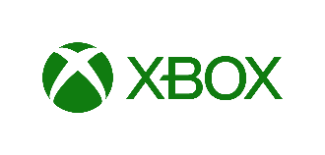

Microsoft Xbox team embraces SRE role to build game streaming
“
“Decoupling the service code from the infrastructure through containerization has been the largest contributor, but the CI/CD pipeline we’ve built has also enabled us to do things like service delivery optimization, green/blue deployments, and canary deployments.”
Challenge: | The Xbox Reliability Engineering and Operations (xREO) team used to spend a lot of time performing repetitive, manual tasks to maintain data centers, deploy new code, and react to issues. When the team was tasked with supporting project xCloud, a game streaming experience with extreme low latency requirements for gamers around the world, they needed to reinvent the way they worked.
Solution: | Early in the project, the development team recognized that they needed to engage the xREO to help design and build a new architecture that would take advantage of the global reach of Azure. Starting with containers to decouple the service code from the infrastructure and Kubernetes as the obvious choice for orchestration, the teams selected the fully managed Azure Kubernetes Service (AKS) to eliminate a lot of the management complexity.
Technology: | For repeatability and automation, they built a CI/CD pipeline with Azure Pipelines, using Azure Resource Manager templates to rapidly provision resources.
James Whitesides, SRE PM, Xbox Reliability and Operations
Click icon to learn more
Notes:
https://azure.microsoft.com/en-us/solutions/devops/devops-at-microsoft/xbox-sre/
https://azure.microsoft.com/mediahandler/files/resourcefiles/devops-at-microsoft-game-streaming-sre/DevOps%20at%20Microsoft%20-%20Xbox%20game%20streaming%20SRE.pdf

